Slide 1
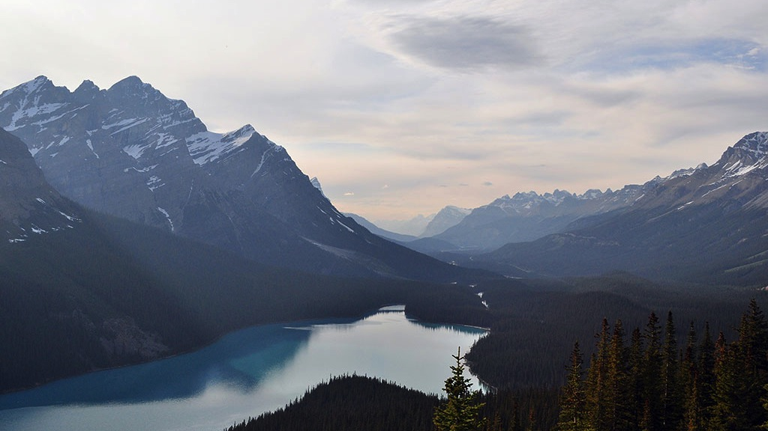


STARTING AT 4:03 PM
NODE.JS GLOBAL
MENTORING PROGRAM
GLOBAL LAUNCH APRIL 2018 - JULY 2018

Slide 2

AGENDA
GENERAL INFORMATION
PROGRAM CONTENT
HOMEWORK AND DEADLINES
COMPLETION CRITERIA
CURATOR’S RESPONSIBILITIES
MENTOR’S RESPONSIBILITIES
MENTEE’S RESPONSIBILITIES
RECOGNITION
HOW TO USE GROW
PROGRAM CONTACTS
USEFUL INFORMATION
Q&A

Slide 3
GENERAL INFORMATION
Node.js Global Mentoring Program (NGMP)
Comprehensive training where more experienced colleagues (mentors/trainers) are sharing their knowledge and skills regarding Node.js competency with young professionals (mentees) helping them to speed up their professional skills and reach the next level of their personal development
Aimed on making production-ready experts

Slide 4

PROGRAM CONTENT
1 NODEJS INTRODUCTION
2 NODEJS MODULES. NPM
3 NODEJS EVENTS
4 ASYNC DEVELOPMENT INTRODUCTION
5 COMMAND LINE. DEBUGGING. ERRORS HANDLING
6 FILESYSTEM AND STREAMS
7 ASYNCHRONOUS NETWORK API
8 HTTP MODULE
9 MIDDLEWARE. FRAMEWORKS
10 AUTHORIZATION. VALIDATION. SECURITY
11 SQL DATABASES. ORM
12 NOSQL DATABASES. ODM
13 NODEJS. TESTING
14 DEPLOY AND TOOLS
15 SWAGGER. DOCS
All lectures will be conducted for both streams (RU / ENG)
All lectures will be recorded
https://epa.ms/nodejs18

Slide 5
HOMEWORK AND DEADLINES
Task 1 after 2nd lecture
Task 2 after 4th lecture
Task 3 after 6th lecture
Task 4 after 9th lecture
Task 5 after 10th lecture
Task 6 after 11th lecture
Task 7 after 12th lecture
Task 8 after 15th lecture
DEADLINES
Depends on complexity of a module
Will be set individually for concrete task
Home task should be marked from 1 to 5
≥ 3 failed tasks => exclusion from program
Main tool for tracking activity: GROW

Slide 6
COMPLETION CRITERIA
Each task contains individual mark evaluation criteria
If mark is lower than 3 – task is considered failed
Task without a mark is interpreted as failed
Deadlines should not be failed (w/o acceptable reasons)
3+ failed tasks exclude a person from the program run
Performing all tasks is mandatory for Honors Degree

Slide 7
CURATOR’S RESPONSIBILITIES
RUN INITIATION | DURING PROGRAM RUN | PROGRAM RUN FINALIZING
Conduct introductory training session for mentees and mentors | Communicate any issues to stakeholders Schedule and hold regular monthly status meetings with mentors regarding groups’ progress Release any news about Mentoring Program Review the work of mentors | Calculate/collect mentors' rewards and send them to CDM for review and approve Send letters with approved rewards to mentors Prepare lists of participants to be awarded Assign relevant badges for program participants

Slide 8
MENTOR’S RESPONSIBILITIES
RUN INITIATION | DURING PROGRAM RUN | PROGRAM RUN FINALIZING
Establish contact with mentee and create educational plan for him/her | Track Mentee's progress Check Mentee's lectures participation Provide self-study materials for Mentee if it's necessary Check homework and provide extended feedback to Mentee Evaluate Mentee's performance every two weeks and report it to Curator Spend at least two hours a week for coaching sessions with Mentee - to provide feedback, answer their questions Participate Mentor's meeting to discuss next week training material and homework evaluation rules Communicate with Curator if he/she has any issues or suggestions Inform Curator in case Mentee could visit lecture in provided period | Provide common feedback and recommendation for Mentee after program completion Take part in Graduation Meeting

Slide 9
MENTEE’S RESPONSIBILITIES
RUN INITIATION | DURING PROGRAM RUN | PROGRAM RUN FINALIZING
Check entry criteria of Mentoring Program Create educational plan with Mentor | Participate the scheduled training / listen to videos, on time Do homework and demonstrate it to the Mentor, consider his/her feedback and fine tune the homework Completes assignments and other tasks and exercises as assigned by Mentor Provide feedback about problems to Mentor. Ask mentor in case have questions. Participate in weekly meetings about the actual week feedback/retro and next week session discussion. | Get common feedback and recommendation from Mentor Take part in Graduation Meeting

Slide 10
RECOGNITION
Exclusive badges
Honorary diplomas
Personal T-shirts
Unique experience
New connections
Fruitful cooperation

Slide 11
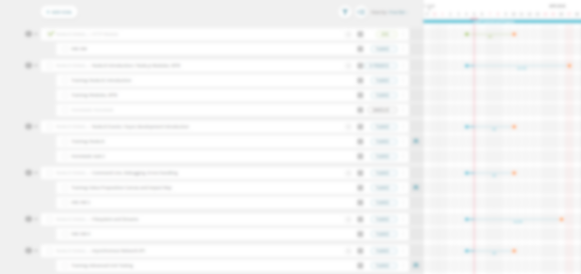
HOW TO USE GROW
DEMO

Slide 12
PROGRAM CONTACTS
PROGRAM MANAGER |  | Vitali Kozlov | vitali_kozlov
CDP MANAGER |  | Ina Novikava | innashp
TRAINING ASSISTANT |  | Natalia Glukhova | nu.byrochkina
LOCAL CURATORS
BY + USA + MX |  | Vitali Kozlov | vitali_kozlov
UA |  | Yevhen Bashmakov | eugene.bashmakov
RU | Ryazan | Dmitry Demidov | dmitri.demidov
 | Izhevsk | Ilia Pushin | avers2007
 | ALL | Vladislav Lomako | lomako.epam
HU |  | Gabor Ocsko | o.gabor.epam
PL |  | Mohamadali Ganji | mohamadali.ganji
KZ |  | Andrey Litvinov | andrej_litvinov_kz
BG |  | Ivelina Kostadinova | icicle_bs

Slide 13
USEFUL INFORMATION
PROGRAM DESCRIPTION
https://epa.ms/ngmp
PROGRAM RUN SCHEDULE Q2 2018
https://epa.ms/ngmp18
SELF-STUDY COURSE FOR MENTORS
https://courses.epam.com/courses/course-v1:epam+GRM+2/about
EPAM FRONT-END SLACK TEAM
https://epamfed.slack.com

Slide 14
Q&A

Slide 15
THANK YOU
AND GOOD LUCK!

